Slide 1
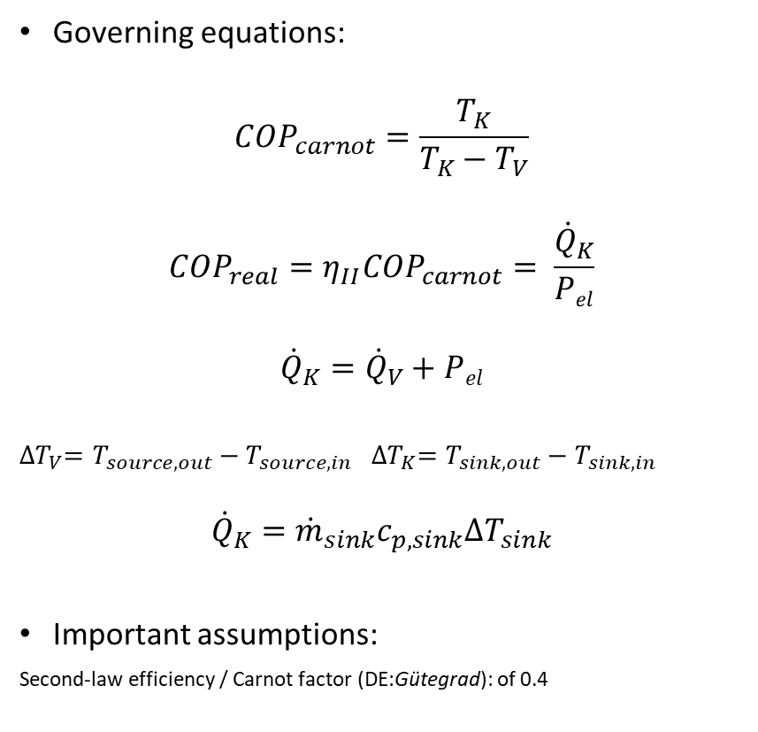
Component: Heat pump Conceptual diagram, equations, assumptions
c_{p,source}
P_{el}
ṁ_{source}
T_{source, in}
T_{sink, out}
Governing equations:
$${COP}_{carnot}=\frac{T_{K}}{T_{K}−T_{V}}$$
$${COP}_{real}=η_{II}{COP}_{carnot}= \frac{{\dot{Q}}_{K}}{Pel}$$
$${\dot{Q}}_{K}={\dot{Q}}_{V}+Pel$$
${∆T}_{V}=T_{source, out}−T_{source, in}$ ${∆T}_{K}=T_{sink, out}−T_{sink, in}$
$${\dot{Q}}_{K}={\dot{m}}_{sink}c_{p, sink}{∆T}_{sink}$$
Important assumptions:
Second-law efficiency / Carnot factor (DE:Gütegrad): of 0.4
Cond.
T_{K}
Evap.
T_{v}
Q̇_{v}
Q̇_{K}
T_{source, out}
T_{sink, in}
ṁ_{sink}
c_{p,sink}

Slide 2
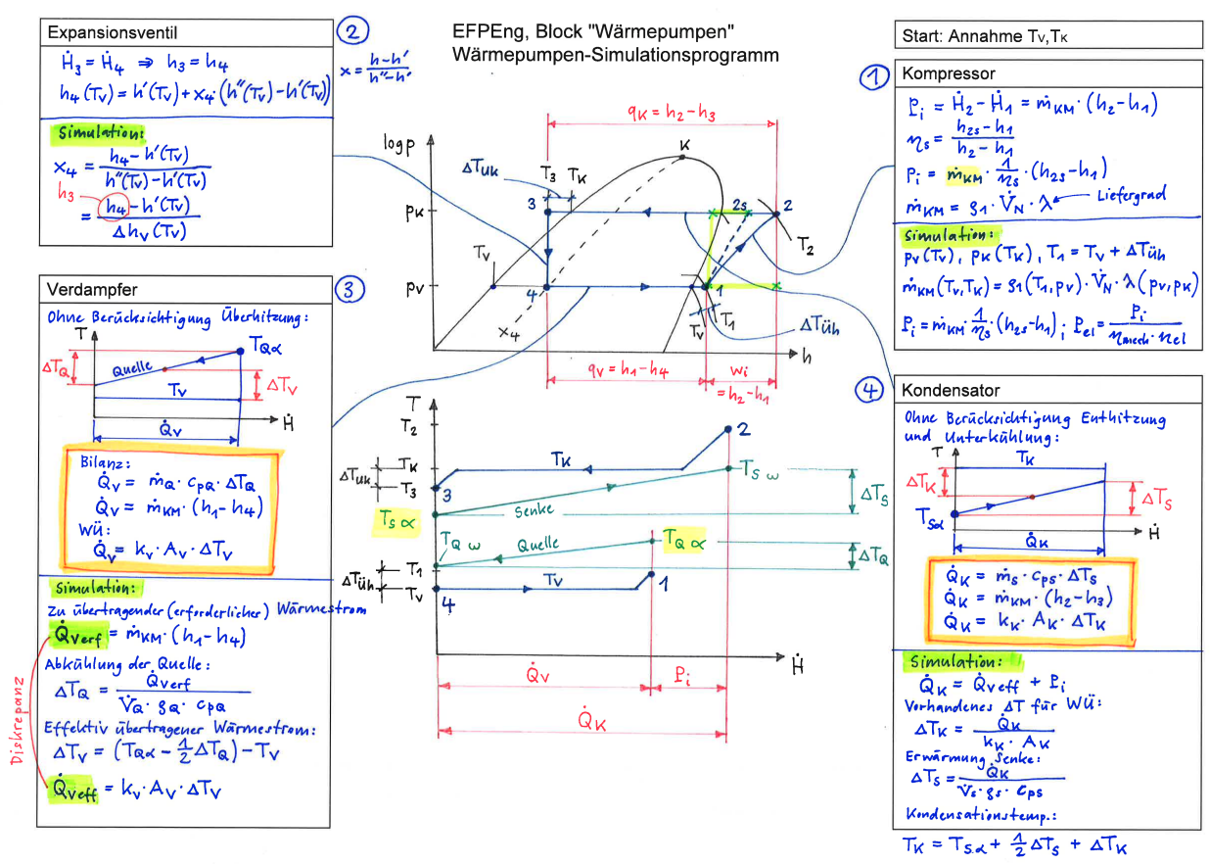
Component: Heat pump Theory notes

Slide 3
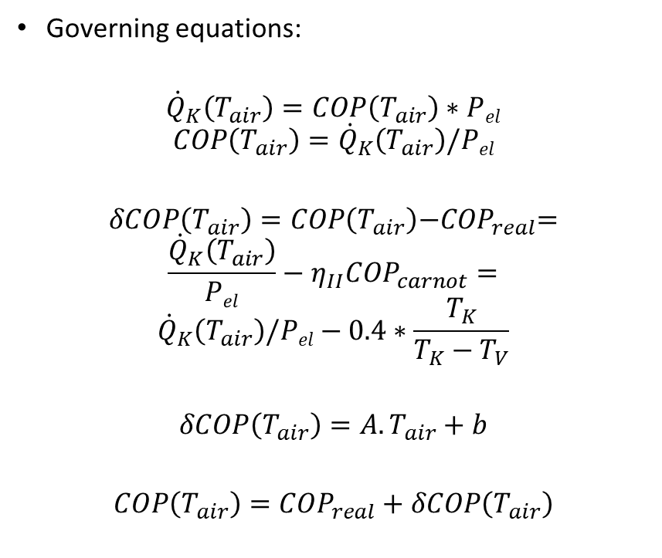
Component: Heat pump Computation sequence
Governing equations:
$${\dot{Q}}_{K}\left(T_{air}\right)=COP\left(T_{air}\right)∗Pel$$
$$COP\left(T_{air}\right)={\dot{Q}}_{K}\left(T_{air}\right)/Pel$$
$$δCOP\left(T_{air}\right)=COP\left(T_{air}\right){−COP}_{real}=$$
$$\frac{{\dot{Q}}_{K}\left(T_{air}\right)}{Pel}−η_{II}{COP}_{carnot}=$$
$${\dot{Q}}_{K}\left(T_{air}\right)/Pel−0.4∗\frac{T_{K}}{T_{K}−T_{V}}$$
$$δCOP\left(T_{air}\right)=A.T_{air}+b$$
$$COP\left(T_{air}\right)={COP}_{real}+δCOP\left(T_{air}\right)$$
Plain english:
Condenser duty is a function of air inlet temp, because the COP is also a function of the air inlet temp
The difference between the observed COP and the real COP (as defined by carnot COP x guetegrad) is deltaCOP which is therefore also a function of the air inlet temp
Plot out deltaCOP across all air temps and fit a line to it
Then we have an air temperature dependent deltaCOP to add to the real COP in order to calculate what the observed COP is going to be

